Slide 1
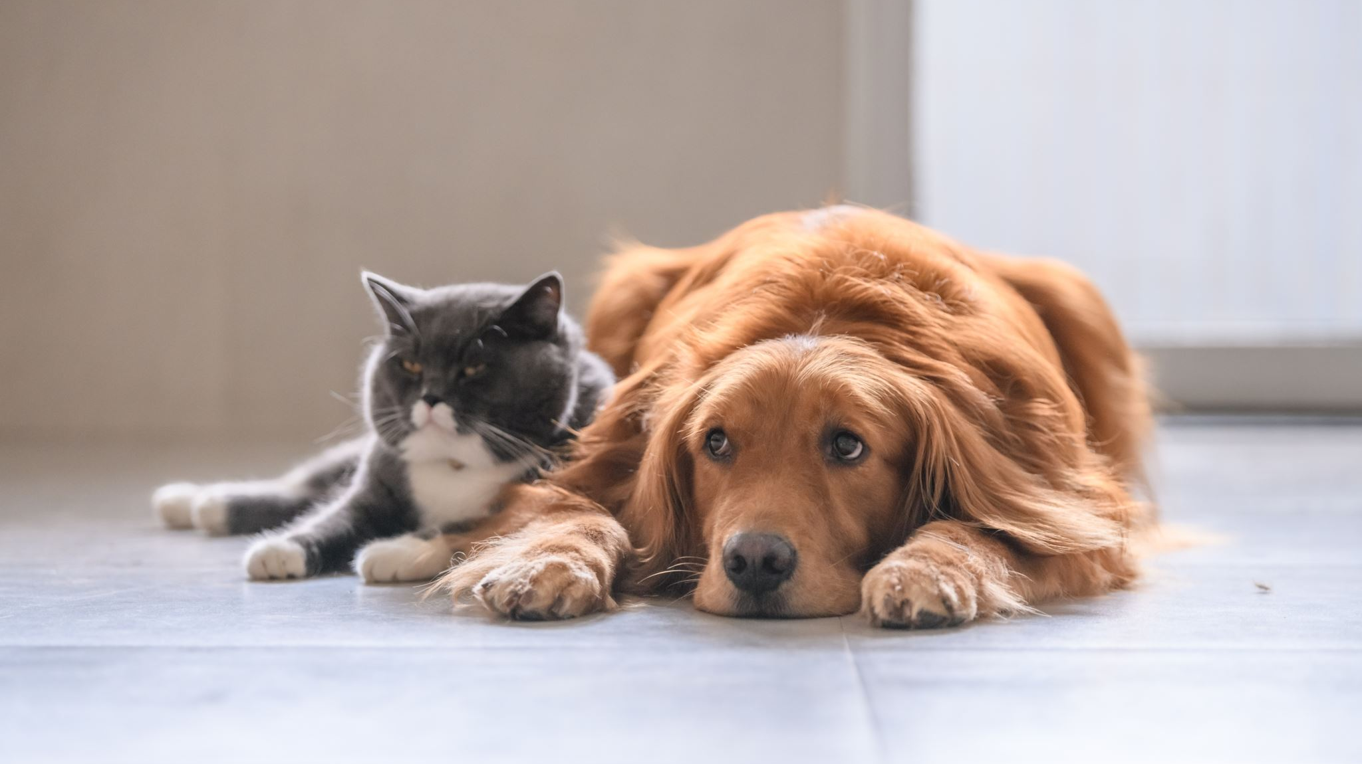
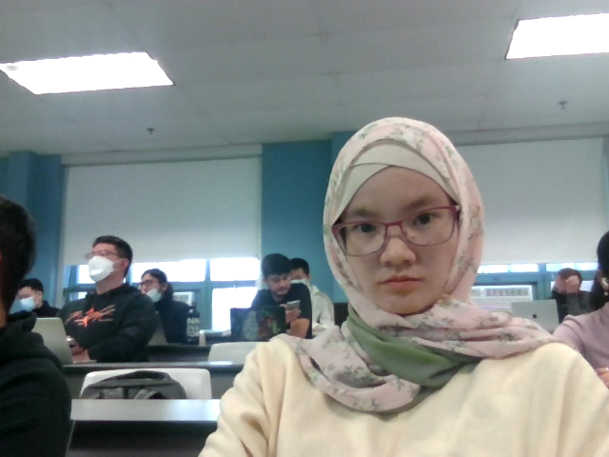
Animal classification
CS767 Machine Learning Term project
Assiya Karatay karatay@bu.edu

Slide 2

Agenda
Data Description
Preprocessing Steps
Observations
Evaluation of the model
Conclusion

Slide 3
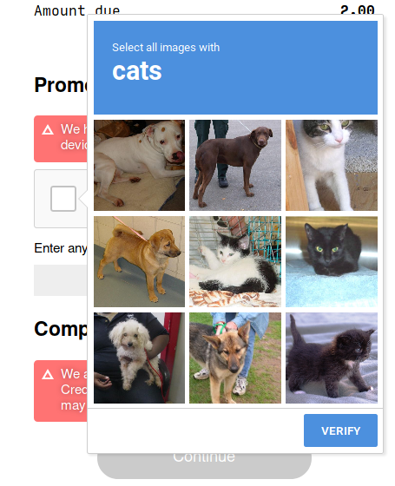
Asirra CAPTCHA works by asking users to identify photographs of cats and dogs.
The goal is to solve the CAPTCHA challenge and demonstrate vulnerability of the system.
The objective is to design and analyze a model for binary classification

Slide 4
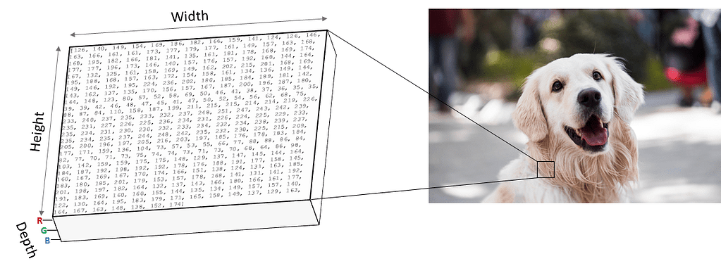

Data description
The data is from CAPTCHA challenge that addresses problems such as
reduce email and blog spam
prevent brute-force attacks on web site passwords.
The Asirra data set is manually classified by people.
The dataset size is 25,000 images of RGB 128*128pixels
dogs
cats
Notes:
Web services are often protected with a challenge that's supposed to be easy for people to solve, but difficult for computers.
Such a challenge is often called a CAPTCHA (Completely Automated Public Turing test to tell Computers and Humans Apart) or

Slide 5
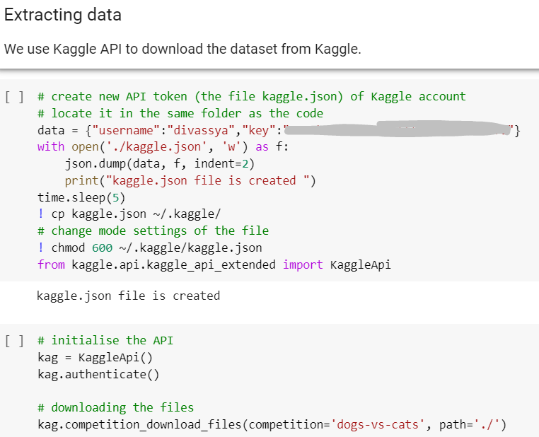
Data preprocessing. Kaggle API
We use the Kaggle API to extract the data from the Kaggle database. It was successful so we do not download any files manually.

Slide 6
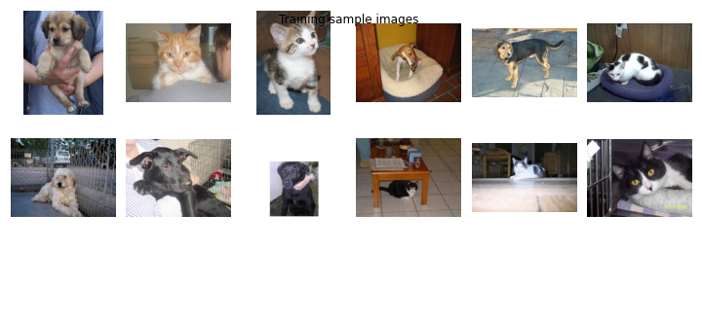
Data preprocessing
80%
16000
Validation
4000
20%
Train
Test
5000
We divided into three subsets because validation data is exposed to the model during training. The best hyperparameters were chosen based on the highest accuracy on the val data. Then we evaluated our model on test data to know about overfitting, underfitting and get different metrics.
Notes:
We divided into three subset, because validation data is exposed to the model during training and best hyperparameters were chosen based on the highest accuracy on the valdata. Then we evaluated our model on test data to know about overfitting, underfitting and get different metrics.

Slide 7
Observations
Sigmoid
Dropout 50%
Fully Connected 512 units
Dropout 25%
Max Pool
Convolution 128,3x3+1(V)
Dropout 25%
Max Pool
Convolution 64,3x3+1(V)
Dropout 25%
Max Pool
Convolution 32,3x3+1(V)
Input
Added Data Augmentation to train data. Data augmentation artificially increases the size of the training set by generating many realistic variants of each training instance. This reduces overfitting, making this a regularization technique
Callbacks:
Early stopping
Reduce the learning rate on plateau monitoring val_accuracy with minimum of 0,00001
Model checkpoint save at each epoch
Dropout 25%
Achieving subsampling with MaxPooling2D to reduce the noise
Adding Batch Normalization after each convolutional layer increased test accuracy from 82% to 90%
optimizer='adam'

Slide 8
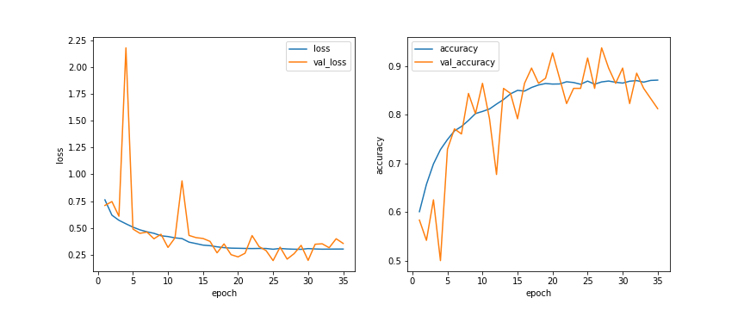
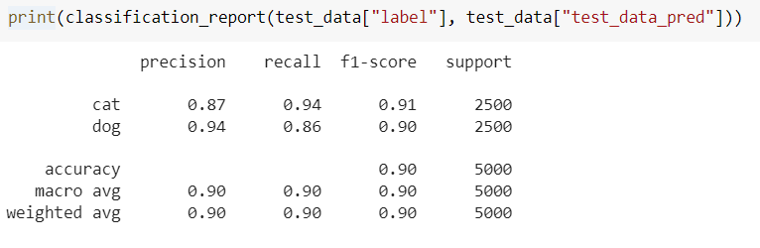
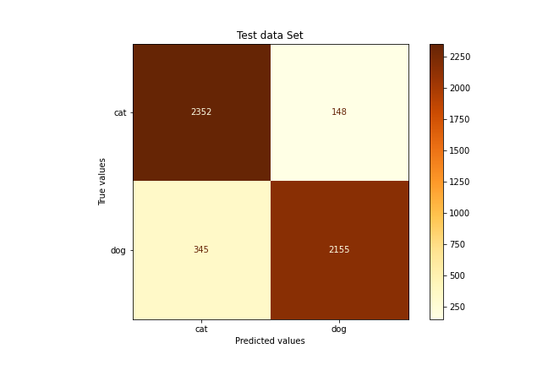
Evaluation of the model
The learning curve
Classification report
Confusion matrix

Slide 9
Conclusion
The results can be used to
to help visually impaired users to bypass CAPTCHA mechanisms in an automated fashion and get the audial version
The project demonstrates that visual-challenge-response approaches like CAPTCHA aren’t reliable.
There is a demand for advanced mechanisms that are difficult for bots to solve
We achieved our aim to design and analyze the Convolutional Neural Network model for animal classification
Find lost pets

